Slide 1
Evangelización
NIVELES DE CONVERSIÓN Y DISCIPULADO
Notes:
Key Content
The wins for the day is:
Build trust with your parish leaders (Shared prayer/lectio)
Generate conversation about evangelization (Thresholds of Conversion)
Presentation Tips
Why are we focused on the Thresholds of conversion?
You are the leaders who encounter other and invite them into your parish community.
The Thresholds of Conversion is a basic evangelization tool to help you encounter others – “How am I encountering people?...How am I meeting people where they are at?”

Slide 2
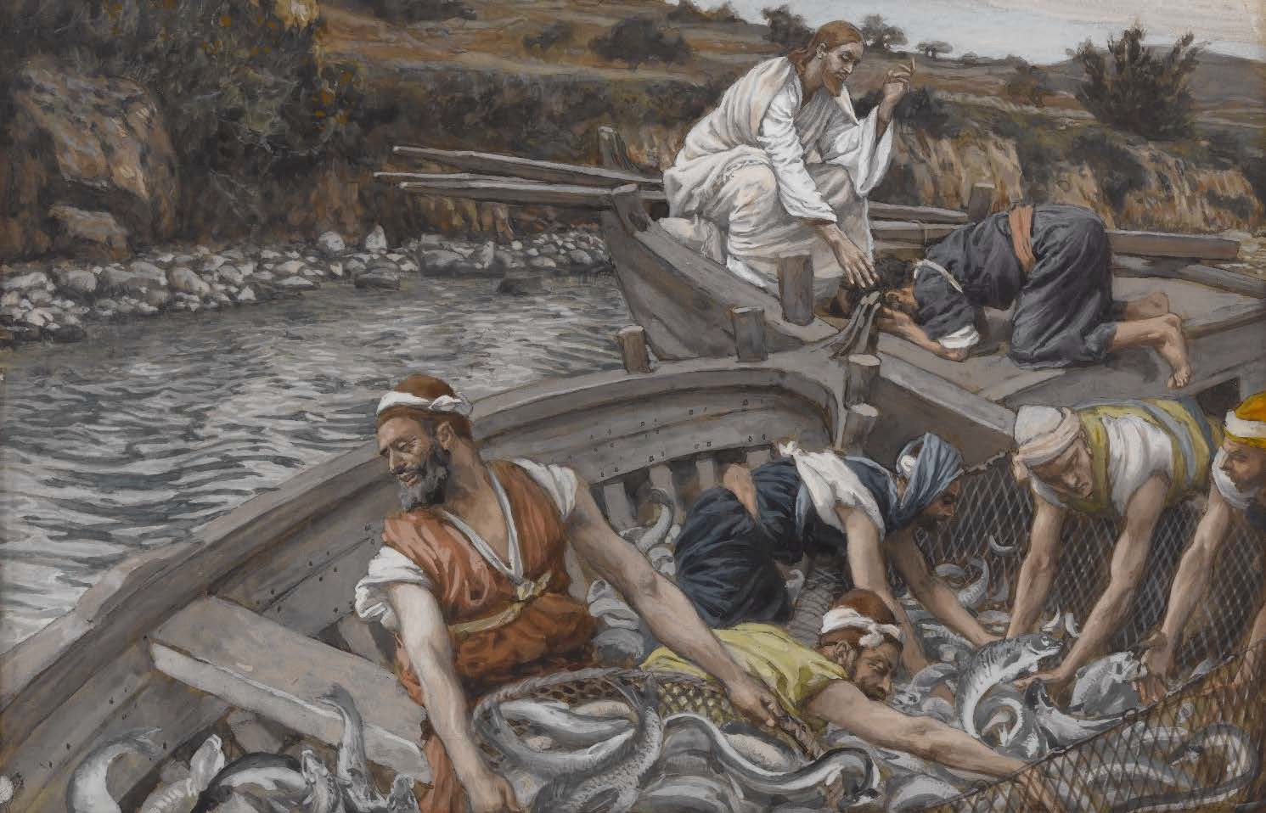
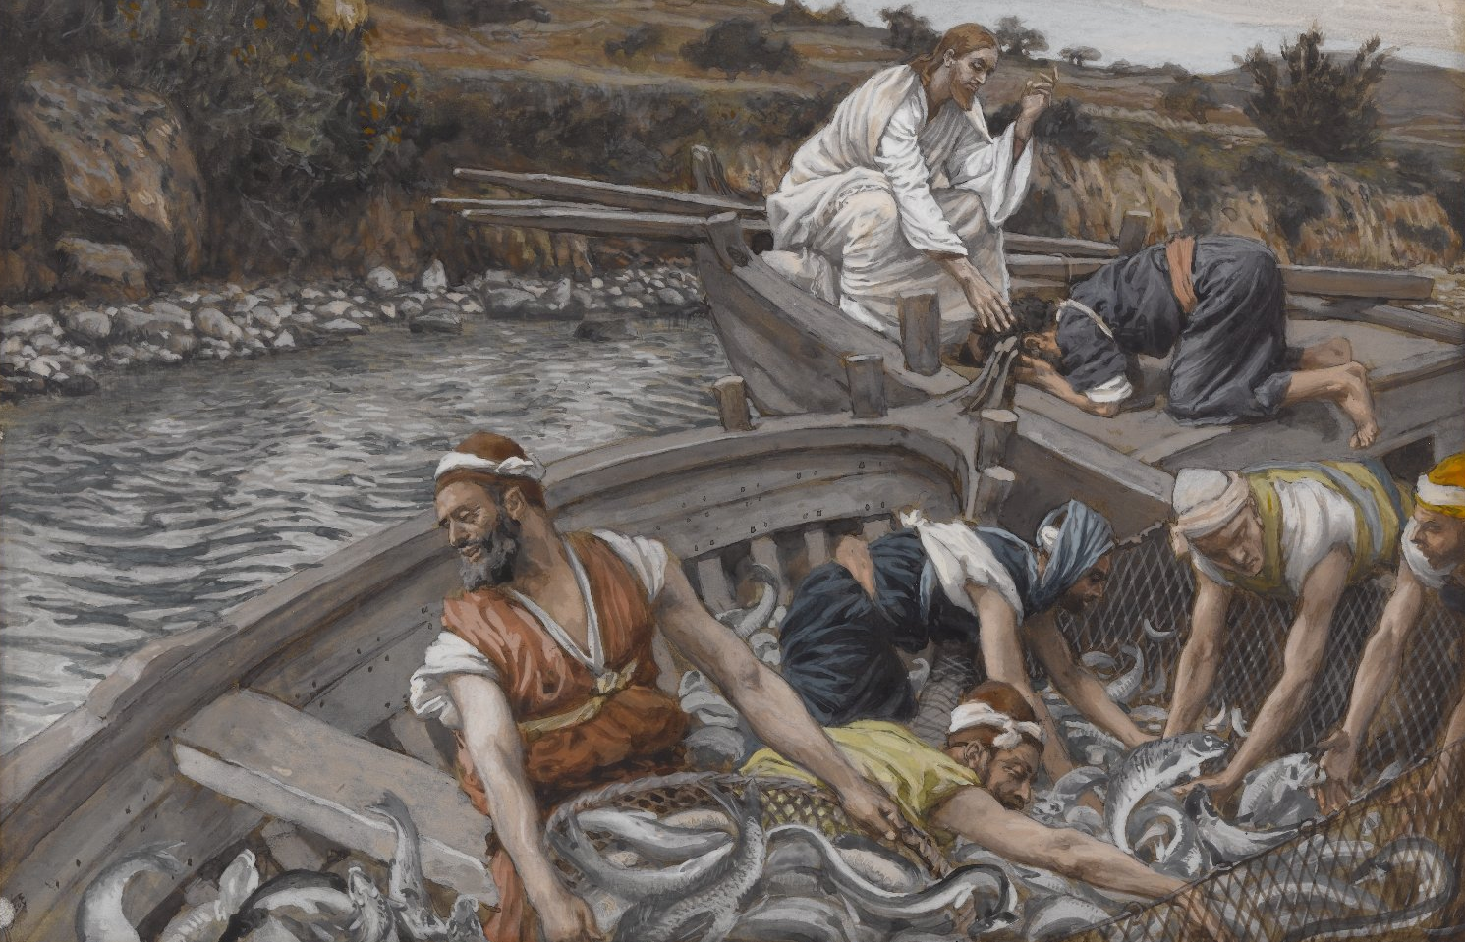
Lucas 5: 1-11
Jesús llama a sus discípulos
Lucas 5: 1-11
Jesús llama a sus discípulos
Notes:
Key Content (15 minutes)
By beginning in prayer, we surrender out time together and everything that comes of this briefing to God. We ask him to send his Holy Spirit, to energize our ministry efforts, and to give us discerning hearts that know the needs of our people.
Presentation Tips
Print enough WRAP Lectio worksheets for each leader you are presenting to
Use the prompts on the back side of the worksheet to guide this time in prayer
Read the passage slowly and give your leaders plenty of time in silence. Let God do the heavy lifting of moving hearts and inspiring minds.

Slide 3
¿Cuál es la misión de la Iglesia?
Entonces, Jesús se acercó a ellos y les dijo: “Me ha sido dado todo poder en el cielo y en la tierra. Vayan, pues, y enseñen a todas las naciones, bautizándolas en el nombre del Padre y del Hijo y del Espíritu Santo, y enseñándolas a cumplir todo cuanto yo les he mandado; y sepan que yo estaré con ustedes todos los días, hasta el fin del mundo”.
-Mateo 28:18-20
Notes:
Key Content (5 minutes for both slide 3 & 4)
The commission to make disciples come from Jesus himself.
Presentation Tips
Have participants read the quote to themselves
Go to next slide

Slide 4
Nuestra identidad más profunda
“Evangelizar constituye, en efecto, la dicha y vocación propia de la Iglesia, su identidad más profunda. Ella existe para evangelizar.”
- Papa Pablo VI, Evangelii Nuntiandi, 14
Notes:
Key Content (5 minutes for both slide 3 & 4)
The mission of the Church, and each of her members, is to make disciples.
Presentation Tips
Have participants read the quotes to themselves
Discuss: How do you, as a parish leader, participate in this mission?

Slide 5
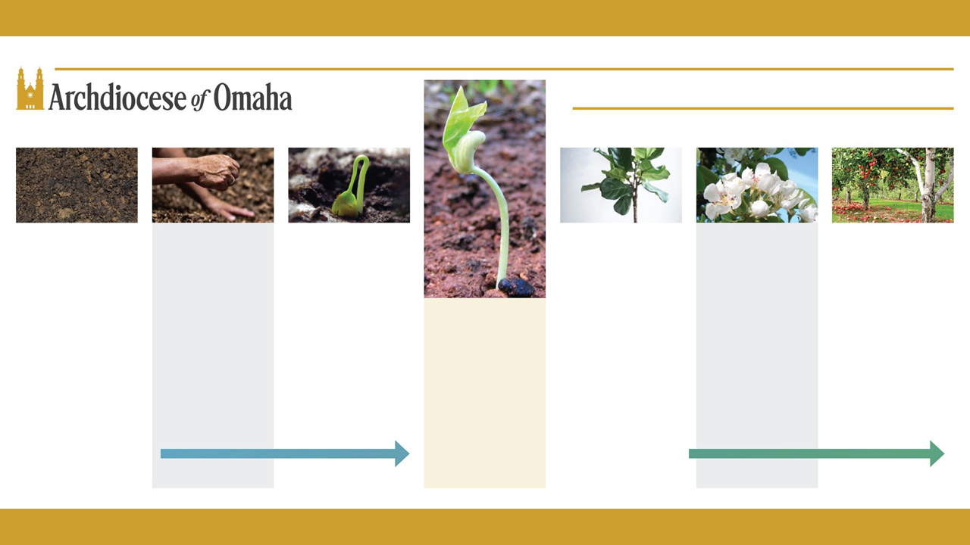
Niveles de Conversión y Discipulado
Confianza | Franqueza | Búsqueda
La persona tiene una asociación positiva con Jesús o un individuo católico y puede empezar a hacer preguntas por curiosidad pasiva. | La persona admite una necesidad o deseo general de cambio espiritual personal. Esto no es lo mismo que un compromiso con cambios específicos. | La persona pasa de un estado de pasividad a una búsqueda activa para conocer al Dios que le llama. El buscador está comprometido en una búsqueda espiritual.
Discípulo Aprendiz
La persona se compromete a seguir a Jesús apartándose del pecado, y hace cualquier sacrificio para crecer personalmente, y vive hábitos de la vida cristiana.
Discípulo Misionero
La persona ha decidido acudir personalmente a la llamada para participar en la misión de la Iglesia compartiendo la Buena Noticia.
Discípulo Ejemplar
La persona está totalmente capacitada para la misión católica de toda su vida y hace cualquier sacrificio para ayudar a otra persona a crecer espiritualmente.
Decisión
La decisión de seguir a Jesús, con fe, como discípulo obediente en medio de la Iglesia, que propicia una vida nueva.
Disposición: Pasiva
Disposición: Activa
Notes:
Key Content (5 minutes)
The Thresholds of Conversion outlines the journey of discipleship and gives meaning to “meet a person where they’re at”
Evangelization happens person to person, one person at a time. Never accept a label in place of a story.
Presentation Tips
Introduction to the Thresholds
Combination of two resources:
Sherry Weddell’s Forming Intentional Disciples
Fellowship of Catholic University Students (FOCUS) Discipleship Roadmap
Focuses on the journey of the individual because - Evangelization happens person to person, one person at a time. Never accept a label in place of a story.
Think of the chart as a continuum moving from left to right. As a person moves through the Thresholds, they increase in:
Trust in the Lord
Love
Relationship with Jesus
Activity/personal initiative to grow
Involvement in the community
This gives meaning to “meet them where they’re at”

Slide 6
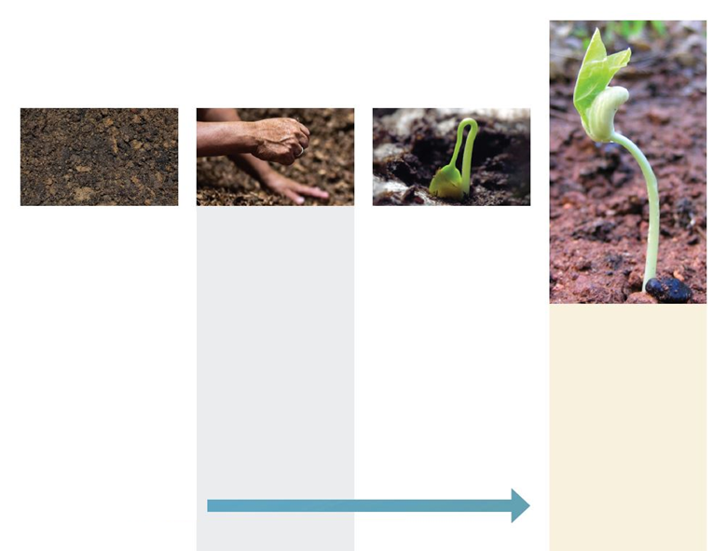
Lado Izquierdo de los Niveles
Confianza | Franqueza | Búsqueda
La persona tiene una asociación positiva con Jesús o un individuo católico y puede empezar a hacer preguntas por curiosidad pasiva. | La persona admite una necesidad o deseo general de cambio espiritual personal. Esto no es lo mismo que un compromiso con cambios específicos. | La persona pasa de un estado de pasividad a una búsqueda activa para conocer al Dios que le llama. El buscador está comprometido en una búsqueda espiritual.
Decisión
La decisión de seguir a Jesús, con fe, como discípulo obediente en medio de la Iglesia, que propicia una vida nueva.
Disposición: Pasiva
Notes:
Key Content (5 minutes for slides 6,7 & 8)
Briefly explain the LEFT-SIDE of the thresholds map (Trust to Decision)
Presentation Tips
Read each threshold description
Note how the picture ties in
Trust → the soil is tilled
Openness → planting seeds
Seeking → seed begins to sprout
Decision → the seed has found good soil and begins to grow

Slide 7
Tiempo de Jugar
Notes:
Key Content (5 minutes for slides 6,7 & 8)
Game instructions found on next slide

Slide 8
Instrucciones
Usando la página de Personas del Lado Izquierdo: De la Confianza a la Decisión
Por turnos, lean en voz alta a los adultos del lado izquierdo.
Discutir en grupo dónde colocarlos en el mapa.
Escriba el nombre de la persona en un umbral.
Notes:
Key Content (5 minutes for slides 6,7 & 8)
Game Instructions
In your small group you will have 10 minutes to,
Take turns reading aloud the descriptions for each adults found on the handout titled “Left Side Personas”
Discuss as a group where to put each person on the map
Write each name under a threshold on your map
Once you are done, we will discuss your answers as a large group
Presentation Tips
The worksheet of personas is labeled “Left Side Personas: Trust to Decision”
Laura to Robert
There are seven personas total for the left side
See notes on next slide for conducting the large group discussion

Slide 9
Notes:
Key Content (10 minutes to play the game; 10 minutes to discuss answers)
This is a buffer slide while small groups discuss the LEFT-SIDE personas and assign them to a threshold
Conduct a large group discussion about where groups placed people on the map
Presentation Tips
The point is to generate discussion to propel learning & understanding – How do we encounter people and meet them where they are at?
How did it go? Was it hard? Easy?
Who was the most difficult to place on the map? Why?
Did you put anyone in between thresholds?
What did you notice when discussing each person?
Did you disagree on where to place people?
Clicking to the next slide you will see the four titles and pictures of left-side Thresholds
A second click will reveal the answers.

Slide 10
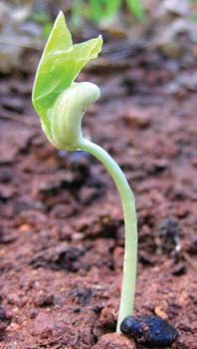
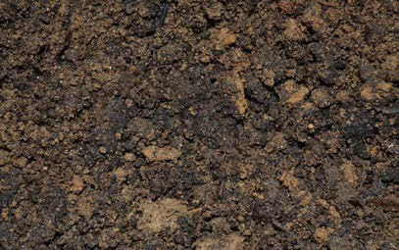
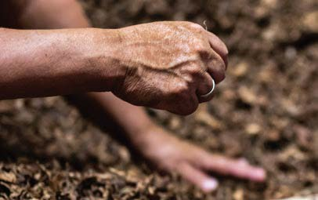
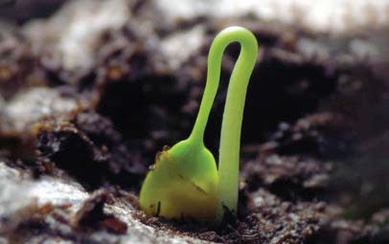
Decisión
Confianza
Franqueza
Búsqueda
John
Charlie
Paula
Maria
Megan
Laura
Robert
Notes:
Key Content (5 minutes for slides 10 & 11)
Reveal LEFT-SIDE answers
Evangelization happens person to person, one person at a time. Never accept a label in place of a story.
Presentation Tips
Our aim to generate conversation in the large group to propel learning and understanding – How do we encounter people and meet them where they are at?
Can you see that people in these early thresholds don’t care how much you know? They want to know how much you care.
Example of misguided evangelization (Giving your sister a book on apologetics when she isn’t ready to trust the Church or her people.)

Slide 11
Decisión
Confianza
Franqueza
Búsqueda
Paula
Megan
Notes:
Key Content (5 minutes for slides 10 & 11)
Highlight key people on the map
Paula - just divorced & dissatisfied with direction of her life à talk to Catholic Friends
A key marker of openness is dissatisfaction - pain is often a catalyst to openness
Megan - The decision to follow Christ as a result of a personal encounter
To make a decision, a person needs to know what they are saying “yes” to The Good News (Kerygma) that Jesus died and rose for them.
Presentation Tips

Slide 12
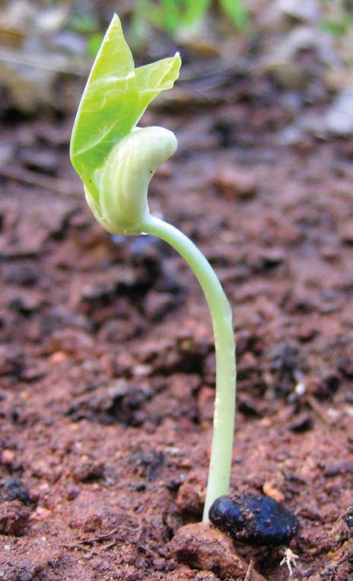
Decisión
La decisión, en la fe, de seguir a Jesús como discípulo obediente en medio de la Iglesia, lo que produce una vida nueva.
Notes:
Key Content (10 minutes for slides 12, 13 & 14)
The necessity of preaching the Good News (Kerygma)
Decision is the hinge of evangelization
There is no true evangelization without the proclamation of Jesus
Faith comes through hearing The Good News (Kerygma)
People need to know what they are saying “yes” to!
Presentation Tips
On the back of the Thresholds map is the Kerygma (The Good News) and the following two quotes:
“All forms of missionary activity are directed to this proclamation…as the hinge on which all evangelization turns.”
(Pope John Paul II, Mission of the Redeemer, 44)
"Evangelization will always contain--as the foundation, center and at the same time the summit of its dynamism--a clear proclamation that, in Jesus Christ...salvation is offered to all people, as a gift of God's grace and mercy."
(Pope Paul VI, Evangelization in the Modern World, 27)

Slide 13
La buena noticia
Dios nos ama y nos hizo para relacionarnos con él y con los demás. (Juan 3:16)
El pecado rompe nuestras relaciones y nos aísla ahora y para la eternidad. (Romanos 6:23)
Jesús restaura nuestra relación con Dios mediante su muerte y resurrección. (Romanos 5:8)
Nuestra respuesta de aceptar a Jesús nos lleva a la vida eterna. (Apocalipsis 3:20)
Notes:
Key Content
What is the Good News?
4 R’s framework – outlined on the back of Thresholds map
There is no true evangelization without the proclamation of Jesus
Faith comes through hearing The Good News
People need to know what they are saying “yes” to!

Slide 14
Pausa y ora
…por alguien que te vino a la mente mientras leías los niveles del lado izquierdo.
Notes:
Key Content
An opportunity for participants to pray for the people they encounter.
Presentation tips
This is a simple moment of silent prayer.

Slide 15
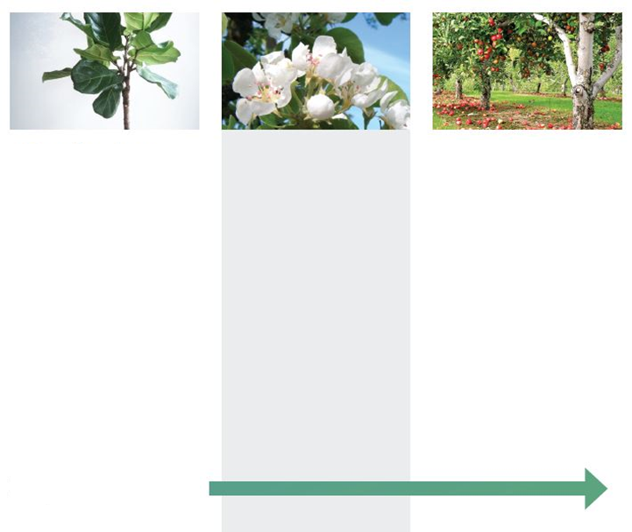
Lado Derecho de los Niveles
Comenzando la Disciplina
Una persona decidió comprometerse con Jesús alejándose del pecado y hace el sacrificio para crecer personalmente, viviendo con hábitos
Disciplina de Misionarios
Una persona que tomó la decisión de responder personalmente a la llamada de formar parte en la iglesia al compartir la buena nueva.
Disciplina Proliferante
Una persona completamente equipada con la misión católica y que hace el sacrificio de ayudar a otros en su crecimiento espiritual.
Disposición: Activa
Notes:
Key Content (5 minutes for slides 15,16 & 17)
Briefly explain the RIGHT-SIDE of the thresholds map (Beginning Disciple to Fruitful Disciple)
Presentation Tips
Read each threshold description
Note how the picture ties in
Beginning Disciple → the tree is growing and trunk is sturdy
Missionary Disciple → the tree is flowering
Fruitful Disciple → the tree is bearing fruit

Slide 16
Tiempo de Jugar
Notes:
Key Content (5 minutes for slides 15,16 & 17)
Game instructions found on next slide

Slide 17
Instrucciones
Usando la página de Personas del Lado Derecho: De discípulo principiante a discípulo avanzado:
Por turnos, lean en voz alta a los adultos del lado derecho.
Discutir en grupo dónde colocarlos en el mapa.
Escriban el nombre de la persona en un nivel.
Notes:
Key Content (5 minutes for slides 15,16 & 17)
Game Instructions
In your small group you will have 10 minutes to,
Take turns reading aloud the descriptions for each adults found on the handout titled “Right Side Personas”
Discuss as a group where to put each person on the map
Write each name under a threshold on your map
Once you are done, we will discuss your answers as a large group
Presentation Tips
The worksheet of personas is labeled “Right Side Personas: Beginning Disciple to Fruitful Disciple”
Ana to Sonja
There are seven personas total for the right side
See notes on next slide for conducting the large group discussion

Slide 18
Notes:
Key Content (10 minutes to play the game; 10 minutes to discuss answers)
This is a buffer slide while small groups discuss the RIGHT-SIDE personas and assign them to a threshold
Conduct a large group discussion about where groups placed people on the map
Presentation Tips
The point is to generate discussion to propel learning & understanding – How do we encounter people and meet them where they are at?
How did it go? Was it hard? Easy?
Who was the most difficult to place on the map? Why?
Did you put anyone in between thresholds?
What did you notice when discussing each person?
Did you disagree on where to place people?
Clicking to the next slide you will see the four titles and pictures of right-side Thresholds
A second click will reveal the answers.

Slide 19

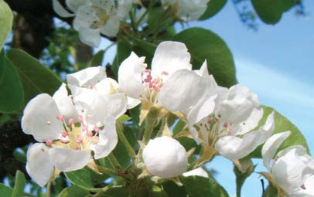
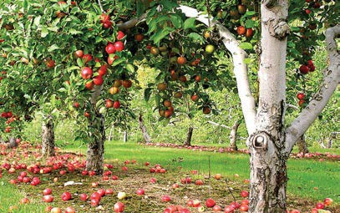
Discípulo
Principiante
Discípulo Misionero
Discípulo Avanzado
Adam
Nic
Evan
Sonja
Jose
Teresa
Ana
Notes:
Key Content (5 minutes for slides 19 & 20)
Reveal RIGHT-SIDE answers
Evangelization happens person to person, one person at a time. Never accept a label in place of a story.
Presentation Tips
Our aim to generate conversation in the large group to propel learning and understanding – How do we encounter people and meet them where they are at?
How many fruitful disciples does your parish have?

Slide 20
Discípulo Misionero
Discípulo Principiante
Discípulo Avanzado
Adam
Evan
Notes:
Key Content (5 minutes for slides 19 & 20)
Highlight key people on the map
Adam - Has Adam made the decision in faith to entrust himself to Jesus?
He could be anywhere from Seeking to Beginning Disciple
Evan - He makes any sacrifice to help another person to grow

Slide 21
Pausa y ora
… por alguien que te vino a la mente mientras leías los niveles del lado derecho.
¿Cómo voy a acompañar a alguien hoy?
Notes:
Key Content
An opportunity for participants to pray for the people they encounter.
Presentation tips
This is a simple moment of silent prayer.

Slide 22
Gracias
Ustedes son los líderes que acompañan a otros y los invitan a nuestra comunidad parroquial.

